Slide 1


FINANCIAL ANALYTICS PROJECT REPORT
Group 21
Dhanshree Hood (G23AI2132)
Kalpit Sharma (G23AI2065)
Priyank Bhardwaj (G23ai2038)
Shubhankit Dutt (G23AI2070)
Nihar Dave (G23AI2097)
Ankush Jha (G23AI2007)

Slide 2
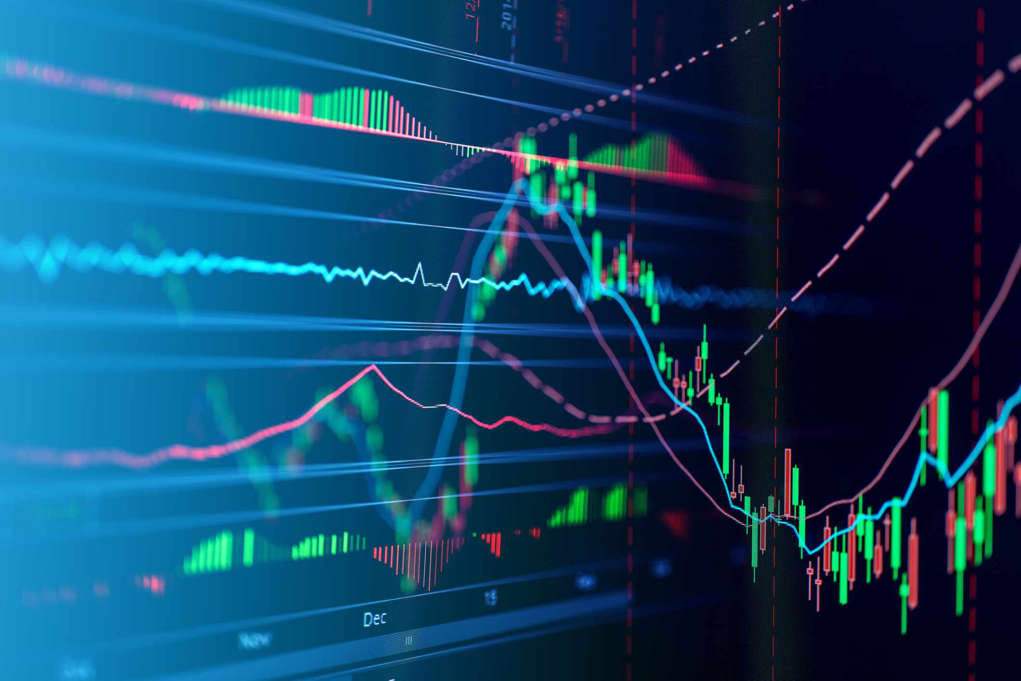
Portfolio Analysis of Indian Stocks
This report provides a detailed analysis of a portfolio consisting of 10 Indian stocks.
The analysis includes calculating stock returns, correlations, descriptive statistics, and the creation of a combined index. Additionally, the report discusses the Markowitz Efficient Frontier, Capital Market Line (CML), and Security Market Line (SML) for optimizing portfolio returns and risk. The combined index return and risk are also calculated.

Slide 3
Objective
Main goals of the analysis:
To compute returns, risks, correlations, and descriptive statistics of selected stocks
To optimize portfolio allocation using the Markowitz Efficient Frontier, CML, and SML

Slide 4
Data Collection and Assets
Stocks Analyzed: List of the 10 selected Indian stocks
Data Source: yahoo finance
Time Frame: January 1, 2021 – January 1, 2024
Purpose: Using historical data to compute stock metrics and optimize the portfolio. Adjusted closing price data for the past three years (from January 1, 2021, to January 1, 2024) is downloaded using the yfinance library.

Slide 5
Technology
Python
The following libraries are imported to perform data analysis and visualization:
yfinance: To download financial data for the selected assets.
pandas: To handle and manipulate the data.
numpy: To perform numerical calculations.
matplotlib and seaborn: For creating visualizations.
scipy: Used for optimization tasks (although not explicitly used in this report).

Slide 6
Calculating Daily Returns
Methodology:
Calculated using pct_change() on adjusted closing prices
Removed missing values with dropna()
Purpose: To establish a basis for risk-return calculations and further analysis

Slide 7
Plotting Asset Data (Time Series and Histogram)
We define a function that plots the time series of asset prices and the histogram of daily returns for each asset. The time series shows how the price evolves over time, while the histogram helps visualize the distribution of daily returns.

Slide 8
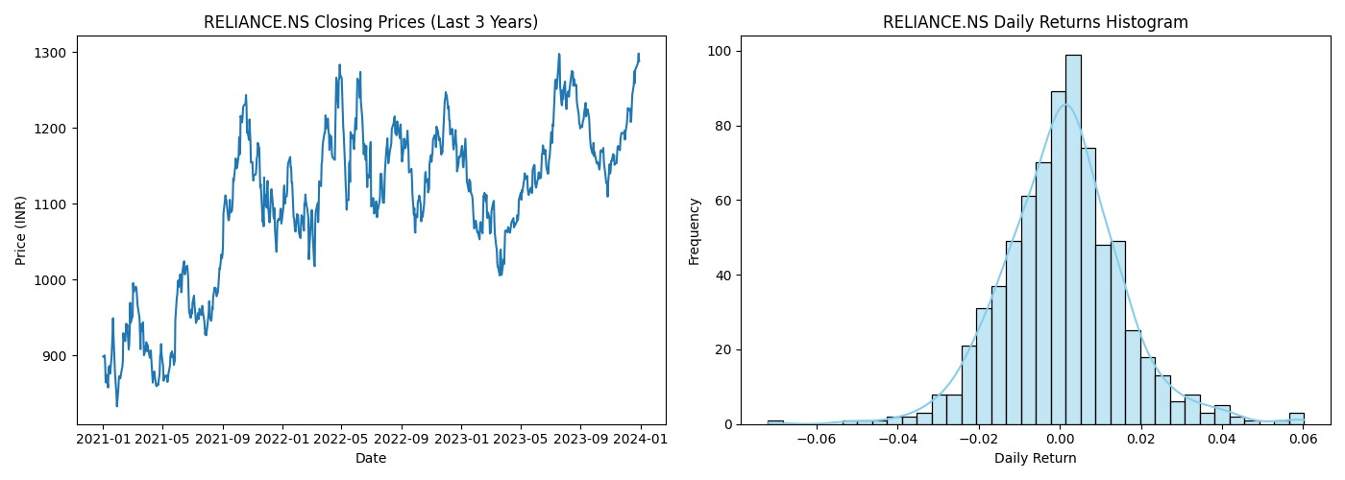

Slide 9
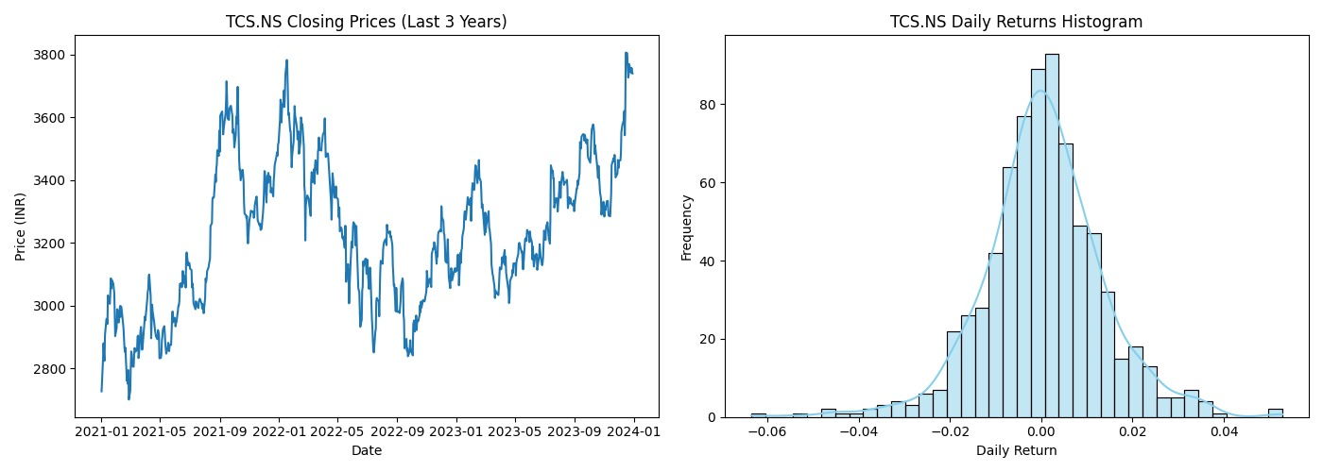

Slide 10
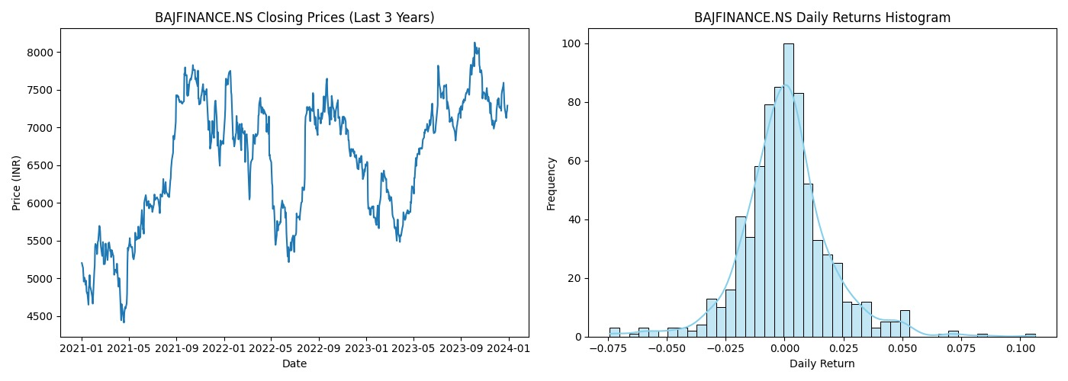

Slide 11
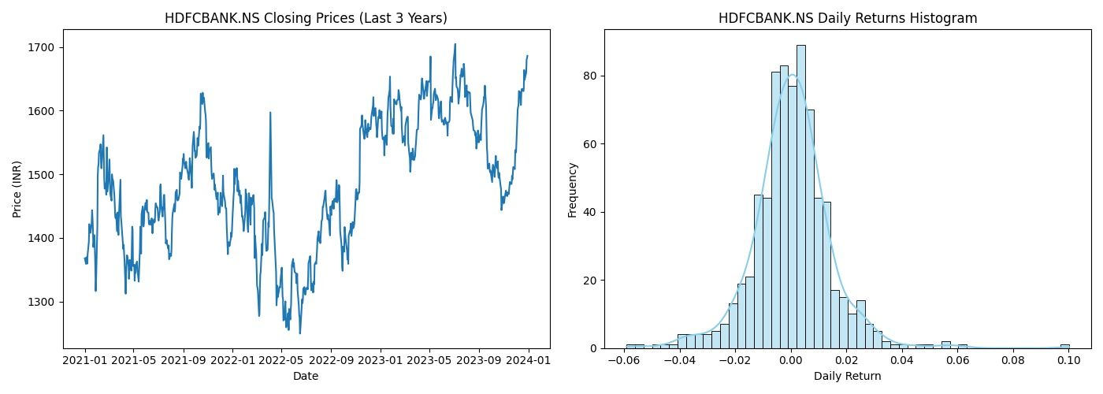

Slide 12
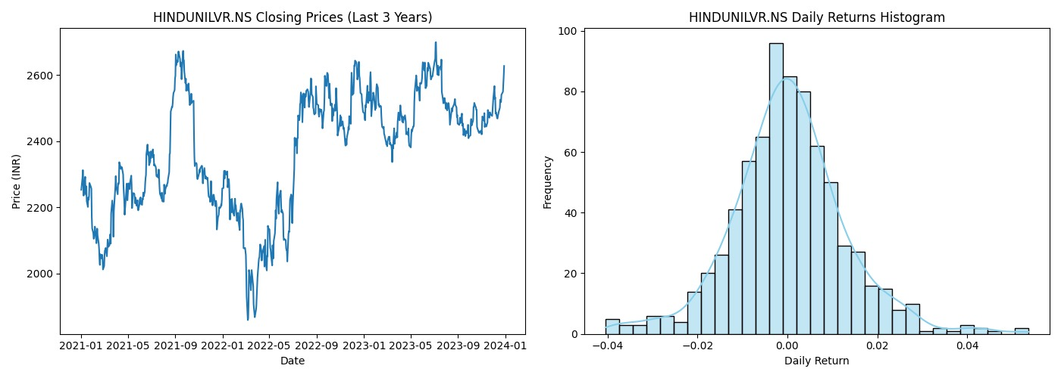

Slide 13
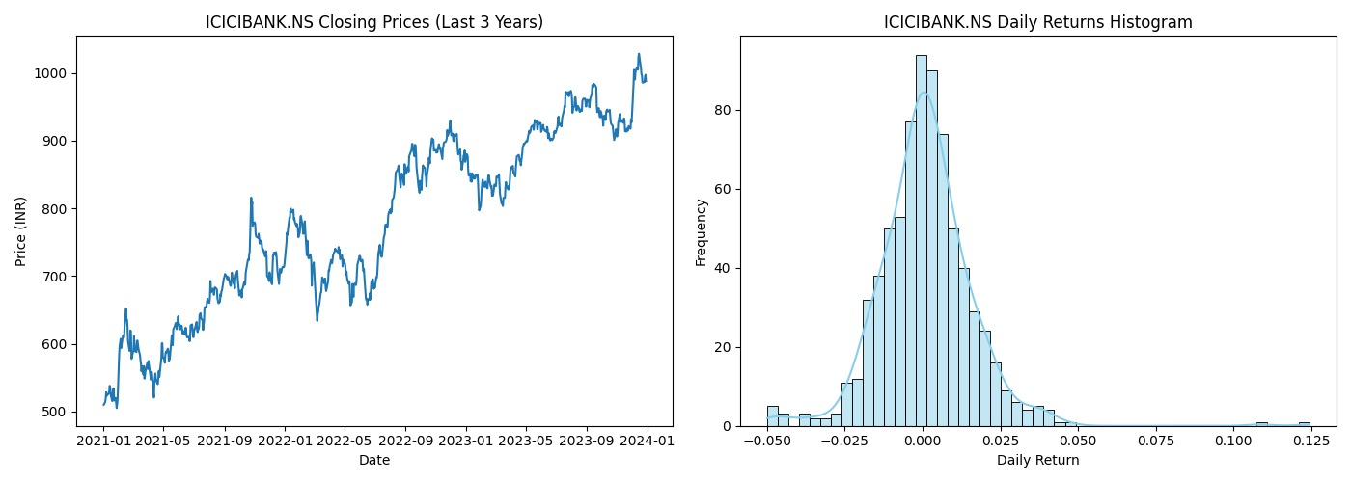

Slide 14
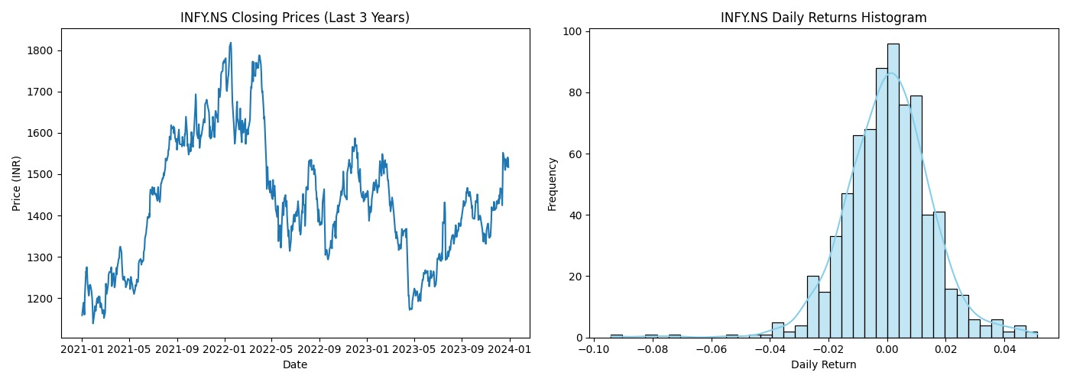

Slide 15
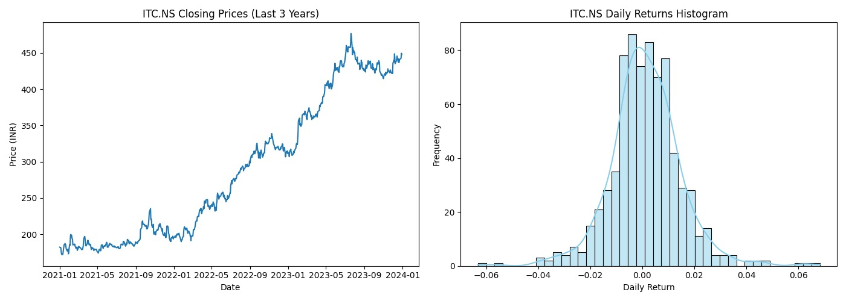

Slide 16
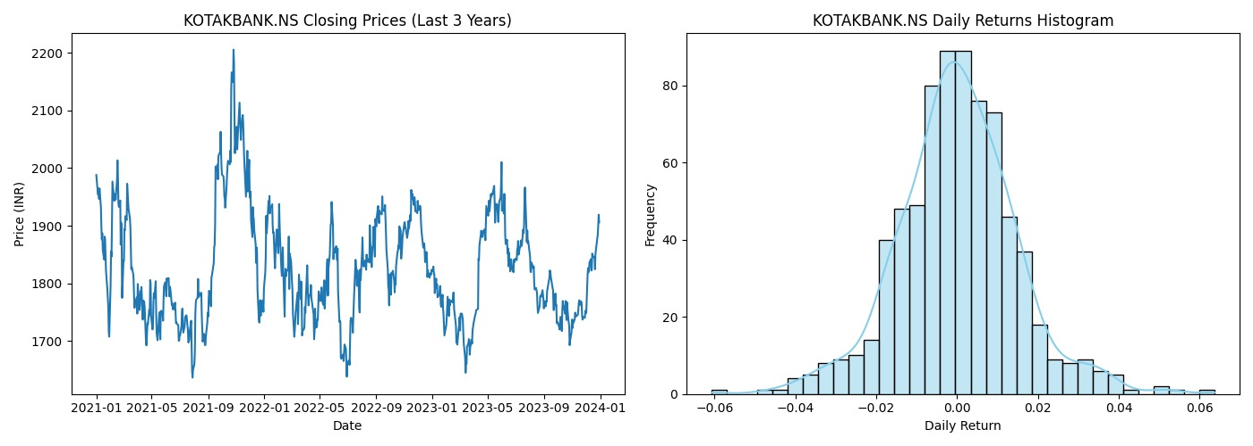

Slide 17
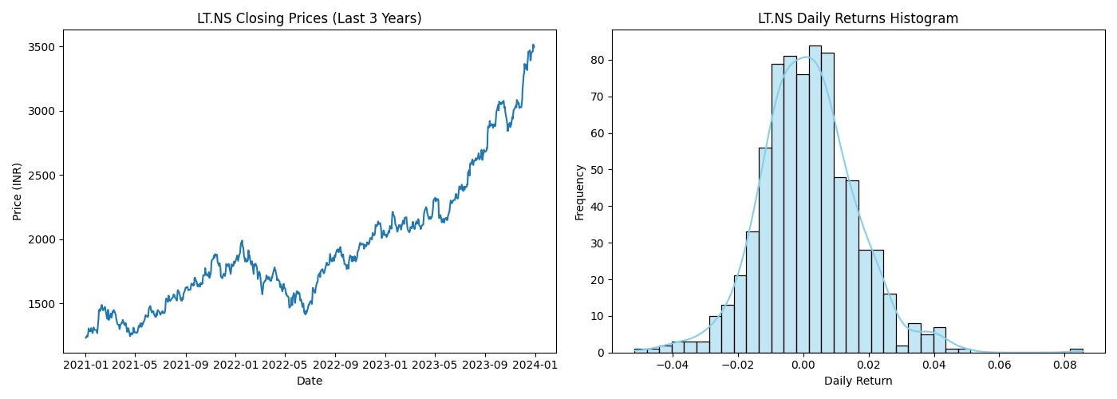

Slide 18
Descriptive Statistics of Returns
Descriptive statistics provide insight into each asset's return behavior:
Metrics Calculated: Mean, standard deviation, skewness, and kurtosis for each asset
Purpose: To understand central tendencies, volatility, and distribution shape, aiding in asset evaluation for risk-return balance

Slide 19
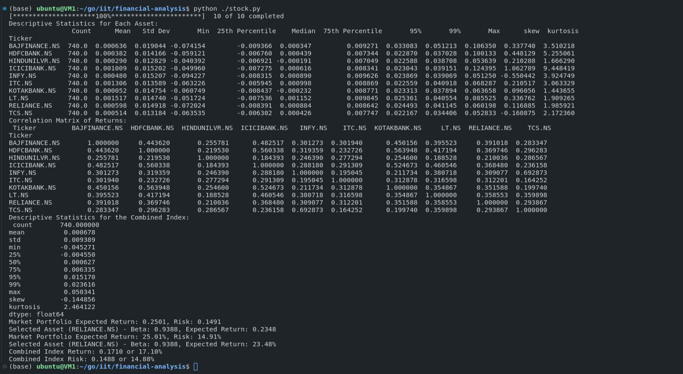

Slide 20
Returns and Descriptive Statistics Findings
Average Return: Each asset’s average return varied significantly, indicating different growth potentials. High mean returns suggest potential profitability, while lower values indicate conservative or stagnant growth.
Volatility (Standard Deviation): Assets like BAJFINANCE.NS and RELIANCE.NS showed higher standard deviations, indicating greater price fluctuations and hence, higher risk. In contrast, HINDUNILVR.NS and ITC.NS had lower volatilities, suggesting stable, lower-risk assets.
Skewness and Kurtosis: Most assets exhibited near-zero skewness, indicating symmetry in returns distribution, while high kurtosis in certain stocks showed frequent extreme returns.

Slide 21
Correlation Analysis & Creating a Combined Index
The correlation matrix of asset returns is calculated to understand how assets move relative to each other. A heatmap is generated to visualize the correlations between the assets.
A combined index is created by calculating the weighted average of the daily returns of all selected assets.
The cumulative returns of this weighted index are calculated, which represents the performance of the combined portfolio.

Slide 22
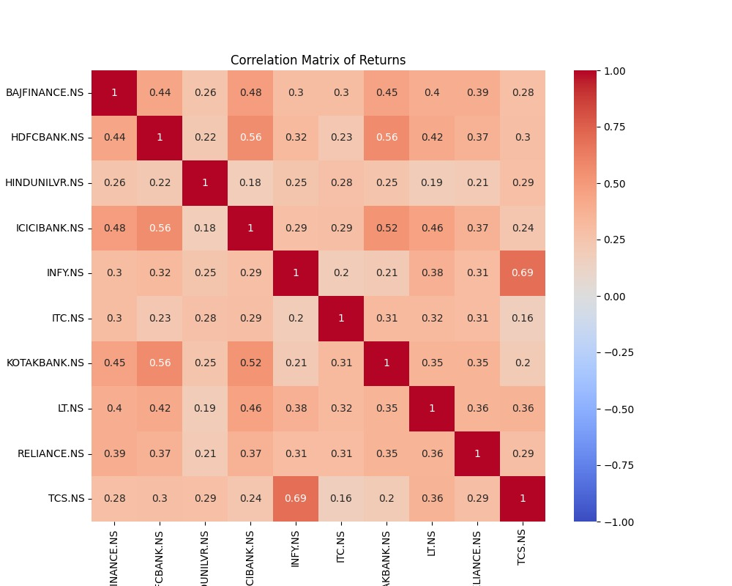

Slide 23
Correlation Analysis Findings
Inter-Asset Correlations: Most assets demonstrated moderate to high positive correlations, suggesting they tend to move in similar directions. For example, banks like HDFCBANK.NS and ICICIBANK.NS showed higher correlations, indicating limited diversification benefit when paired together.
Implications for Diversification: Lower correlations were observed between companies from different sectors, such as IT and FMCG, suggesting these can be combined for effective diversification.

Slide 24
Combined Index Construction
Index Calculation: Constructed by taking a weighted average of daily returns across all assets, assuming equal weights for simplicity.
Cumulative Returns Plot: Shows the combined index’s performance over time, representing an aggregate portfolio return.
Purpose: To track the portfolio’s historical performance and observe how a diversified index of assets performs over time.

Slide 25
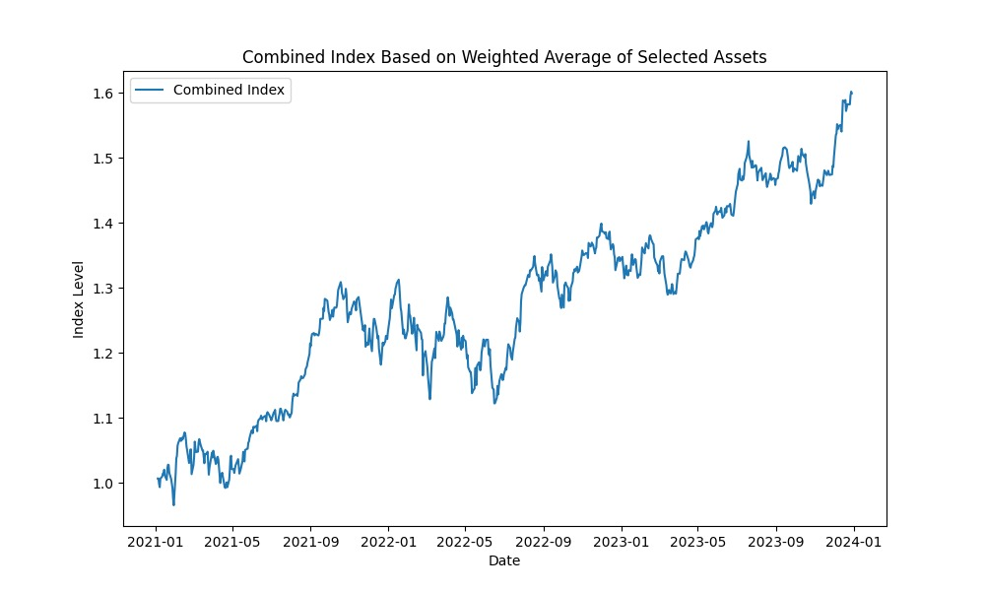

Slide 26
Combined Index Findings
Index Performance: The combined index, created using equal weights for each asset, showed cumulative growth over the period, representing diversified portfolio performance.
Annualized Return and Risk: The combined index yielded an annualized return, moderate compared to individual high-return stocks but with reduced risk due to diversification.
Portfolio Stability: The combined index showed less volatility than high-risk assets alone, emphasizing the risk reduction benefits of diversification.

Slide 27
Markowitz Efficient Frontier, CML, and SML
The Markowitz Efficient Frontier is calculated by generating random portfolios and plotting their return and risk.
Portfolio Performance Calculation: The portfolio_performance function calculates the annualized return and risk (standard deviation) of a portfolio given a set of weights.
Random Portfolios for Efficient Frontier: We generate 5,000 random portfolios and calculate their returns, risks, and Sharpe ratios. These are used to plot the efficient frontier.
Maximum Sharpe Portfolio (Market Portfolio): We identify the portfolio with the highest Sharpe ratio, which we assume to be the market portfolio.
Capital Market Line (CML): The CML is plotted from the risk-free rate to the market portfolio.
The portfolio with the maximum Sharpe ratio is identified as the Market Portfolio.
The Capital Market Line (CML) is plotted to show the optimal risk-return trade-off, and the Security Market Line (SML) is plotted for a selected asset (RELIANCE.NS).

Slide 28
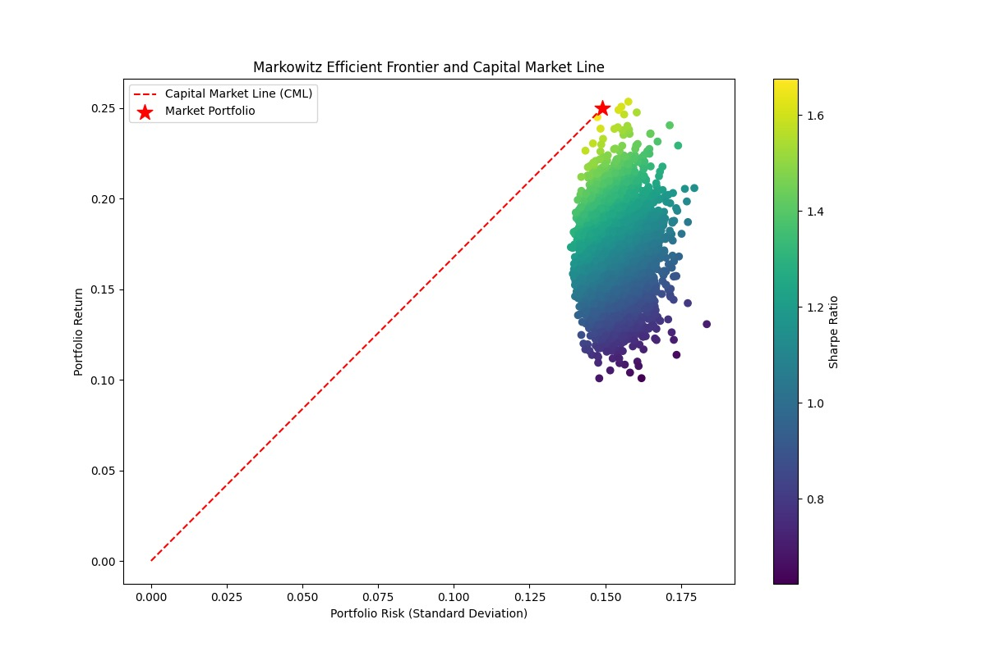

Slide 29
Markowitz Efficient Frontier Findings
Efficient Frontier: The Markowitz Efficient Frontier displayed a set of optimal portfolios with varying risk-return balances, showing that higher returns come with increased risk.
Market Portfolio: The portfolio with the highest Sharpe ratio, known as the Market Portfolio, offered the best risk-adjusted return. This portfolio optimally balances return and risk.

Slide 30
Capital Market Line (CML) Findings
Risk-Return Trade-Off: The Capital Market Line (CML) represents the best risk-return trade-off achievable by combining the risk-free rate with the Market Portfolio.
Market Portfolio on CML: The market portfolio lies on the CML, demonstrating that it is optimal for investors seeking the highest risk-adjusted return.

Slide 31
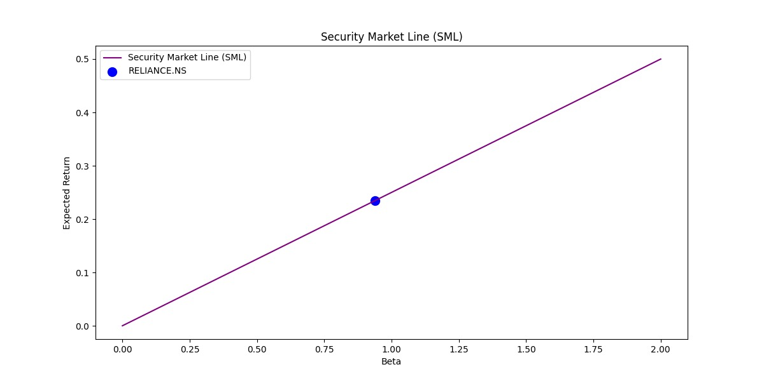

Slide 32
Security Market Line (SML) Findings
Asset Beta: The chosen asset, RELIANCE.NS, was positioned on the SML based on its beta, showing how its return relates to market risk.
Expected vs. Actual Return: RELIANCE.NS’s position on the SML indicates it is priced appropriately for its level of risk. Assets above the SML would be considered undervalued, while those below are overvalued.

Slide 33
Overall Portfolio Performance
Return and Risk of the Combined Index: The combined index showed a balanced return and risk profile, making it suitable for investors seeking moderate growth with managed risk.
Diversification Benefits: The analysis underscored the benefits of combining different assets to reduce overall portfolio risk without a significant compromise on returns.

Slide 34
Conclusion
This report successfully analyzes the portfolio consisting of 10 Indian stocks.
It includes the calculation of returns, risks, correlations, and descriptive statistics.
By using the Markowitz Efficient Frontier, Capital Market Line, and Security Market Line, we can determine the optimal portfolio and expected return for a selected asset.

